Slide 1
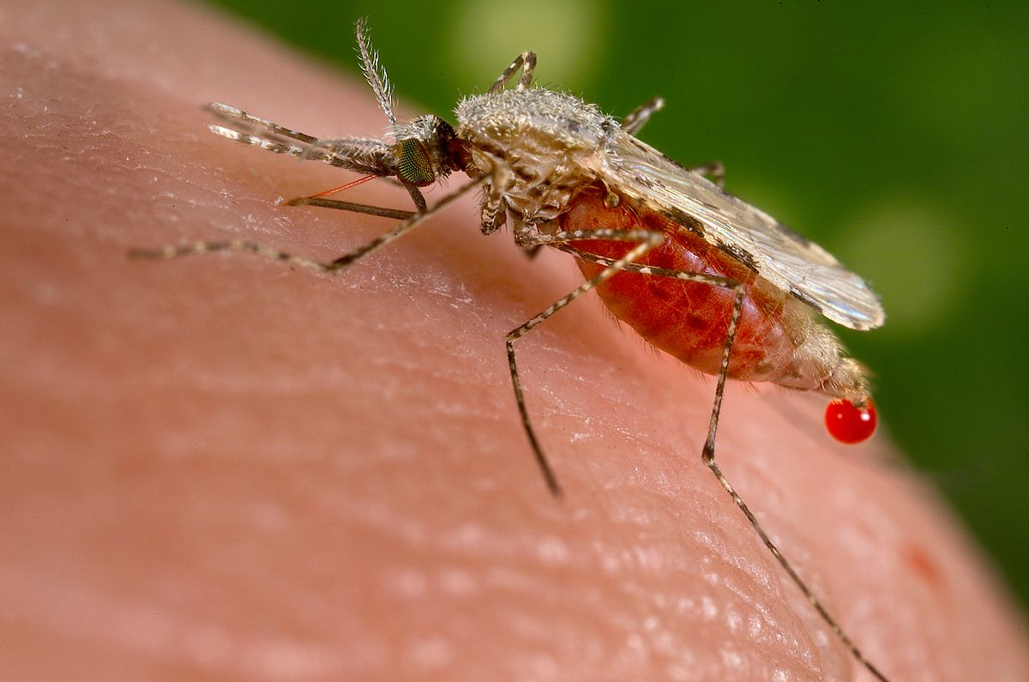
Implement Deep Learning Techniques To Detect Malaria Using IBM Cloud
TEAM –
CHINMAI KANALA-19R11A05F4
DASARI MANNA- 19R11A05F7
G MAITHREYI- 19R11A05F9
EVA KARRA- 20R15A0517

Slide 2
introduction
Malaria is a deadly, infectious mosquito-borne disease caused by Plasmodium parasites. These parasites are transmitted by the bites of infected female Anopheles mosquitoes.
Typically the first symptoms of malaria are similar to the flu or a virus when you usually start feeling sick within a few days or weeks after the mosquito bite. However these deadly parasites can live in your body for over a year without any problems! Thus, a delay in the right treatment can lead to complications and even death.
Hence early and effective testing and detection of malaria can save lives.
It is pretty clear that malaria is prevalent across the globe especially in tropical regions. The motivation for this project is however based on the nature and fatality of this disease. Initially if an infected mosquito bites you, parasites carried by the mosquito will get in your blood and start destroying oxygen-carrying RBCs (red blood cells).

Slide 3
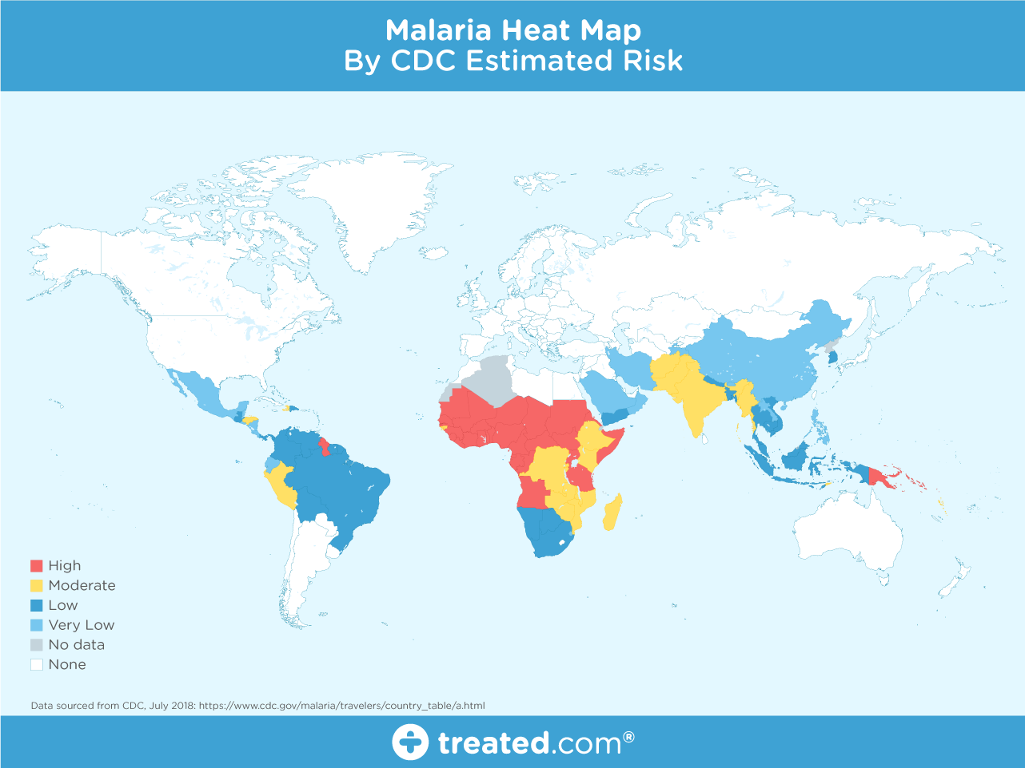
nearly half the world’s population is at risk from malaria and there are over 200 million malaria cases and approximately 400,000 deaths due to malaria every year. This gives us all the more motivation to make malaria detection and diagnosis fast, easy and effective.

Slide 4
why Deep Learning for Malaria Detection?
With regular manual diagnosis of blood smears, it is an intensive manual process requiring proper expertise in classifying and counting the parasitized and uninfected cells. Typically this may not scale well and might cause problems if we do not have the right expertise in specific regions around the world.
Deep Learning models, or to be more specific, Convolutional Neural Networks (CNNs) have proven to be really effective in a wide variety of computer vision tasks.
Automated malaria detection using deep learning models like CNNs could be very effective, cheap and scalable especially with the advent of transfer learning and pre-trained models which work quite well even with constraints like less data.

Slide 5
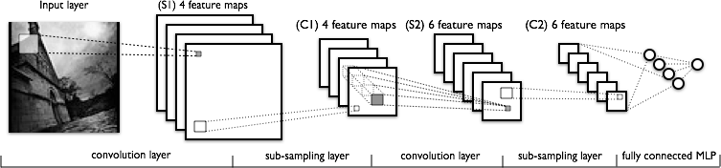
Deep Learning models, or to be more specific, Convolutional Neural Networks (CNNs) have proven to be really effective in a wide variety of computer vision tasks.
Convolution layers learn spatial hierarchical patterns from the data, which are also translation invariant. Thus they are able to learn different aspects of images. For example, the first convolution layer will learn small and local patterns such as edges and corners, a second convolution layer will learn larger patterns based on the features from the first layers, and so on. This allows CNNs to automate feature engineering and learn effective features which generalize well on new data points. Pooling layers help with down sampling and dimension reduction.

Slide 6
A Machine Learning solution for the detection of malaria requires manual input of the parameters — for example, size, color, the morphology of the cells, whereas implementing a Convolutional Neural Network (CNN) algorithm would greatly speed up prediction time while mirroring (or even exceeding) the accuracy of clinicians.
Automated malaria detection using deep learning models like CNNs could be very effective, cheap and scalable especially with the advent of transfer learning and pre-trained models which work quite well even with constraints like less data.
In this project, we will be building a deep learning model that can detect and classify malaria disease. A web application is integrated into the model, from where user can upload an x-ray image and see the analyzed results on User Interface.

Slide 7
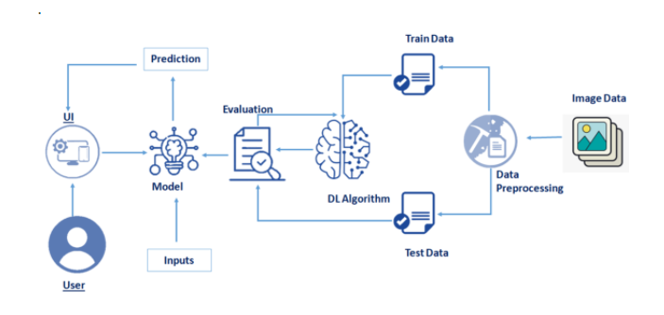
Architecture

Slide 8
Project Flow
DATA COLLECTION
APPLICATION BUILDING
DATA PREPROCESSING
MODEL BUILDING

Slide 9
Datasets
ML depends heavily on data. It’s the most crucial aspect that makes algorithm training possible.
Artificial Intelligence is a data hunger technology, it depends heavily on data, without data, it is impossible for a machine to learn.
In Convolutional Neural Networks, as it deals with images, we need training and testing data set. It is the actual data set used to train the model for performing various actions. In this activity lets focus of gathering the dataset
The dataset used for this project was obtained from Kaggle.
The dataset contains two classes of images :
Infected (Parasitized)
Uninfected

Slide 10
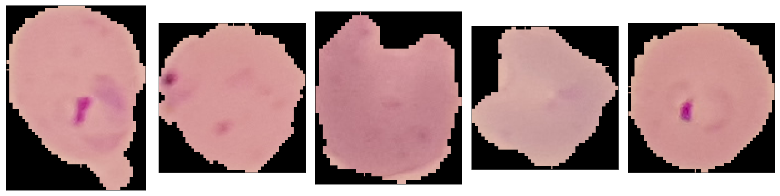
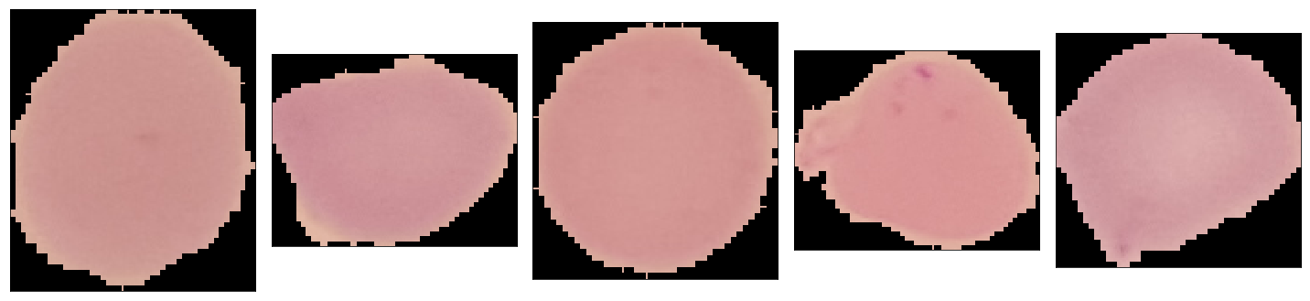
INFECTED
UNINFECTED

Slide 11
IMAGE PREPROCESSING
Image preprocessing are the steps taken to format images before they are used by model training and inference. This includes, but is not limited to, resizing, orienting, and color corrections.
Preprocessing is required to clean image data for model input. For example, fully connected layers in convolutional neural networks required that all images are the same sized arrays.
Image augmentation creates new training examples out of existing training data.
Image Pre-processing includes the following main tasks
Import ImageDataGenerator Library.
Configure ImageDataGenerator Class.
Applying ImageDataGenerator functionality to the trainset and test set.

Slide 12
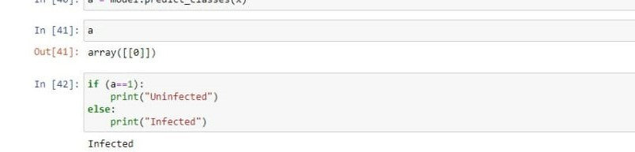
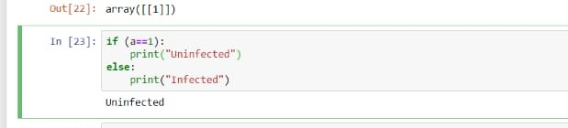
OUTPUT
INFECTED
UNINFECTED

Slide 13
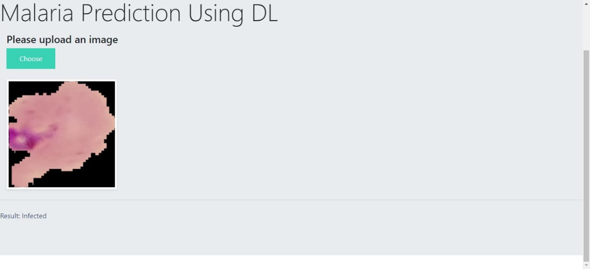
RESULT

Slide 14
CONCLUSION
In this project, we built a deep learning model that can detect and classify malaria disease. A web application is integrated into the model, from where user can upload an x-ray image and see the analyzed results on UserInterface.
A GUI based application which uses a custom CNN model to predict if an uploaded cell image is parasitized or uninfected. System will read the image uploaded by the user, augment it and will use the saved custom model to detect whether the disease is present or not in the patient and thus display the result in a user-friendly language.
Malaria is a curable disease, with drugs available for treatment, including drugs that can help prevent malaria infections in travelers to malaria-prone regions. However, there exists no effective vaccine against malaria yet, although this is an area of active research and field studies. Once infected, malaria is a rapidly progressing disease, with a serious risk of developing into severe and cerebral malaria with neurologic symptoms for P. falciparum infections. Therefore, a timely diagnosis of malaria is very important. Although malaria can be diagnosed in many different ways, there is room for improvement for current malaria diagnostic tests including reducing cost, increasing specificity, and improving ease of use. Through this , we can make the diagnosis of malaria very fast and convenient.
So, more automations must be brought in this field , and make the detection of diseases more effective and accurate.

Slide 15
THANKYOU!

